Slide 1
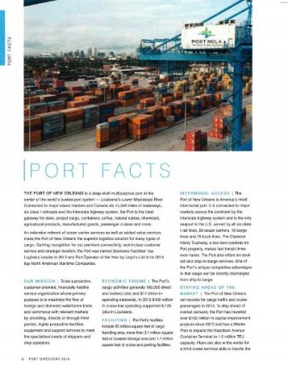
Port of
New Orleans
Official Directory of the Port of New Orleans 2015
Directories/Handbooks
Use this area for logo
(delete text box before placing logo)

